Slide 1
Crowd activity monitoring
N. Mandlik
K.L. Cserna

Slide 2
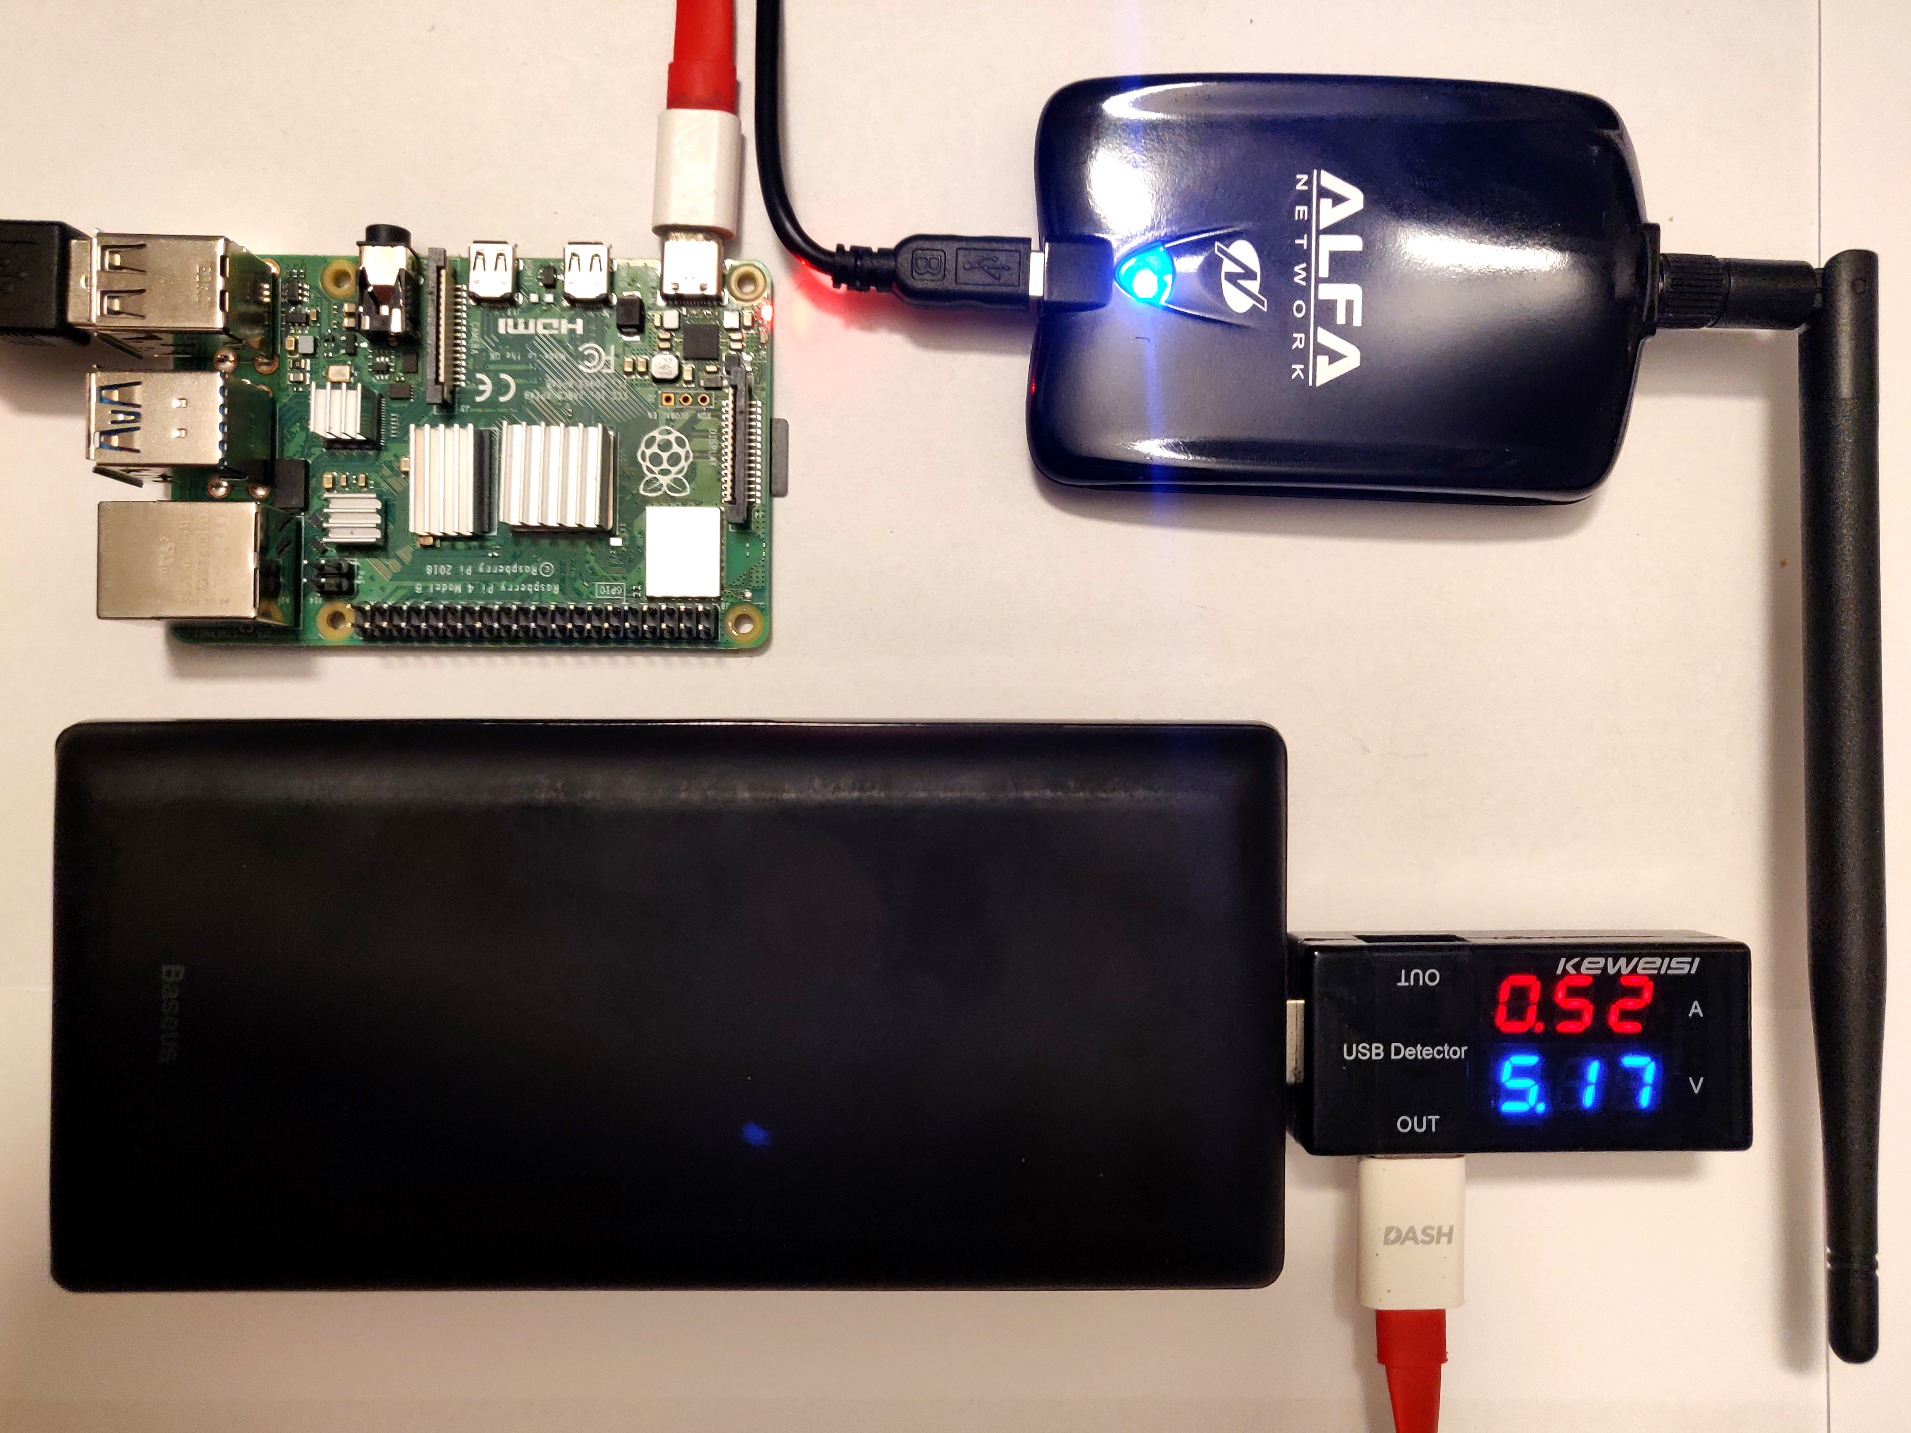
Method
Probe + Non-probe packets
Threshold on RSSI
Hardware
Pi 4
WiFi Adapter
Software
Ubuntu 20.10
Dumpcap
Python
5 Scenes

Slide 3
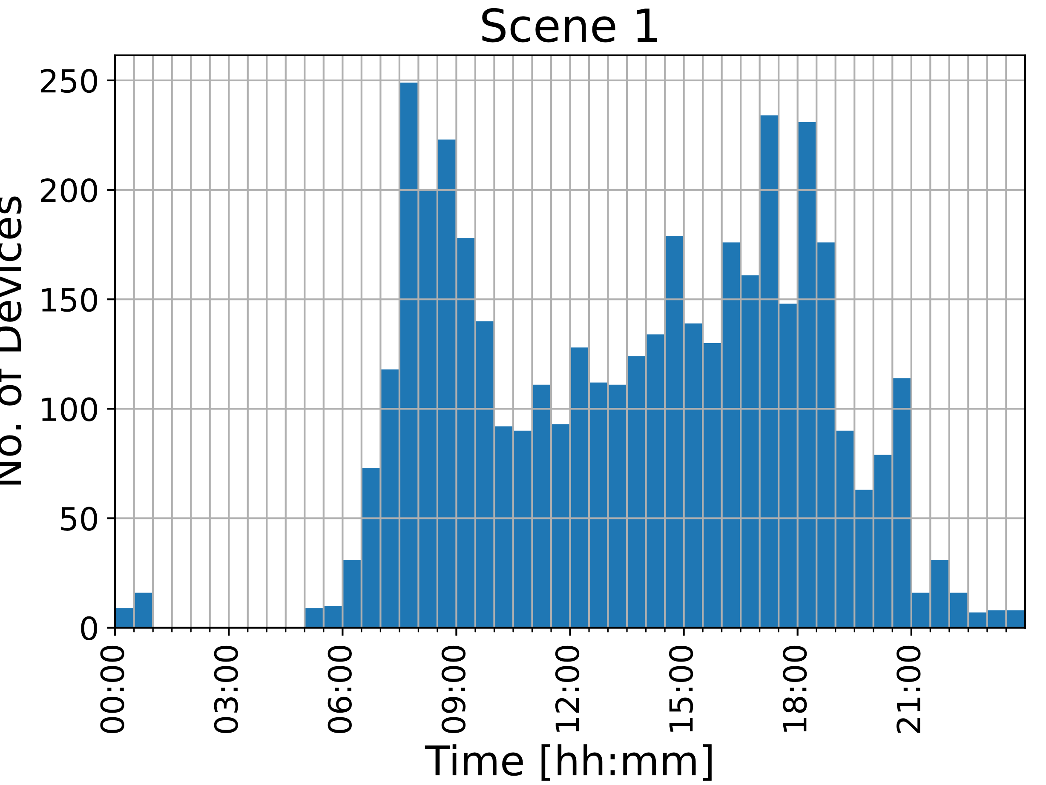
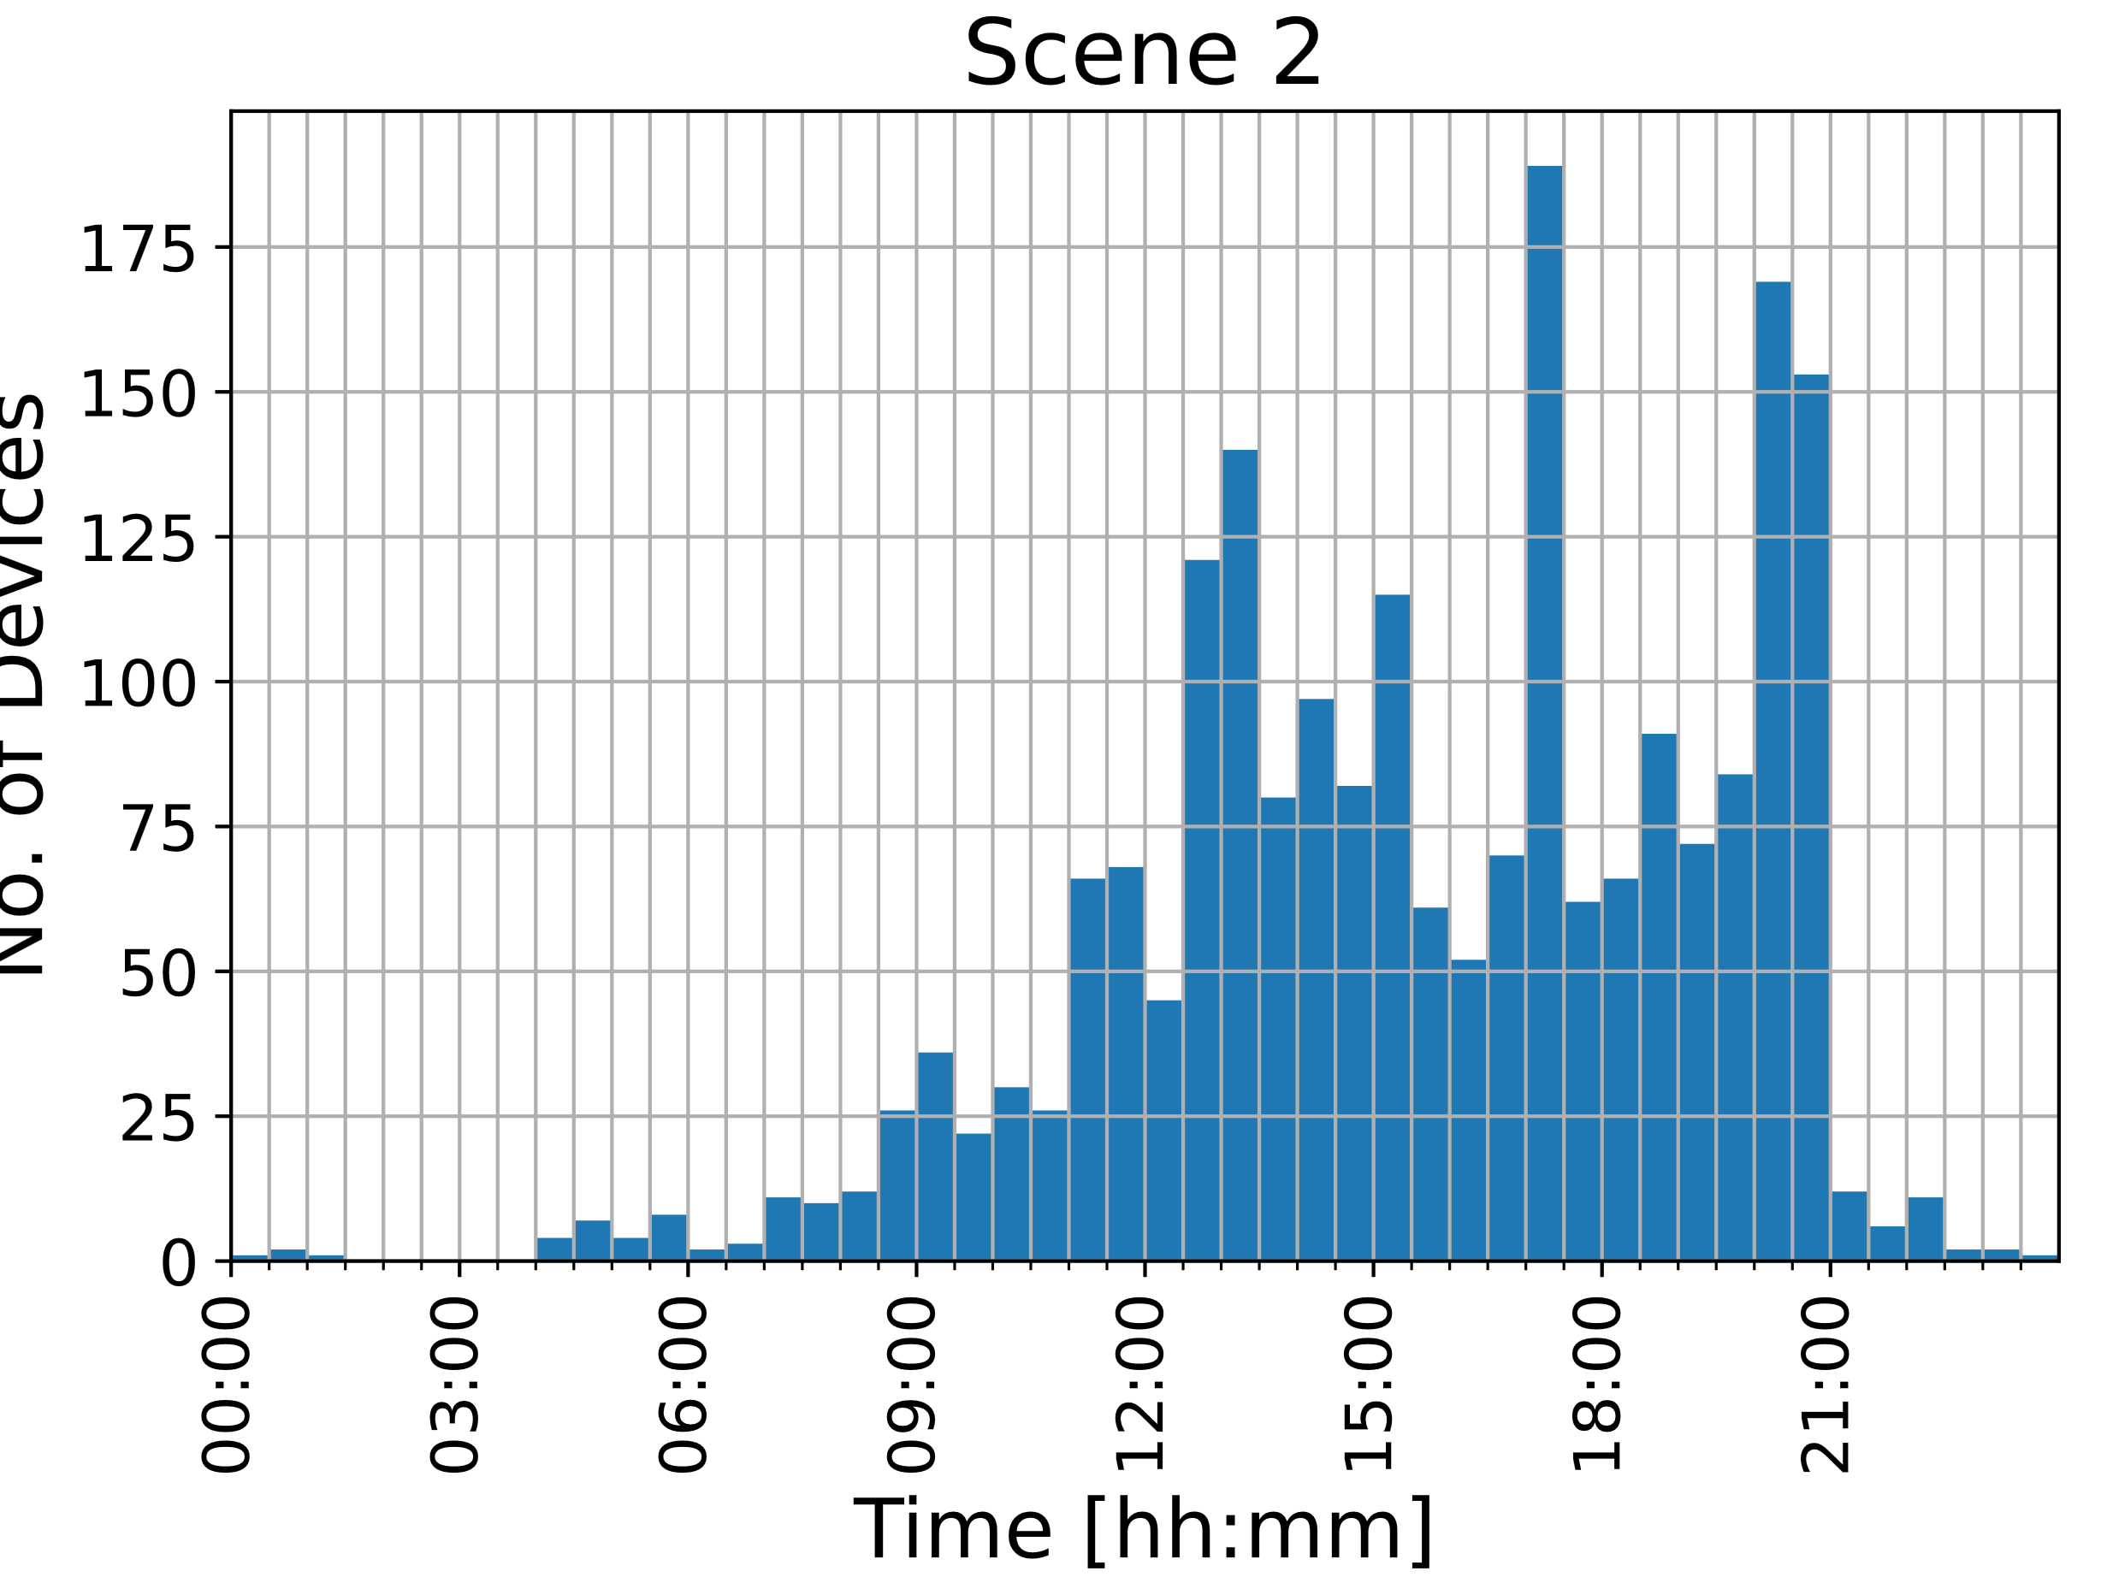
Scenes
24h measurement at each scene
Delft Station Bicycle Parking 1
Weekday
Weekend

Slide 4
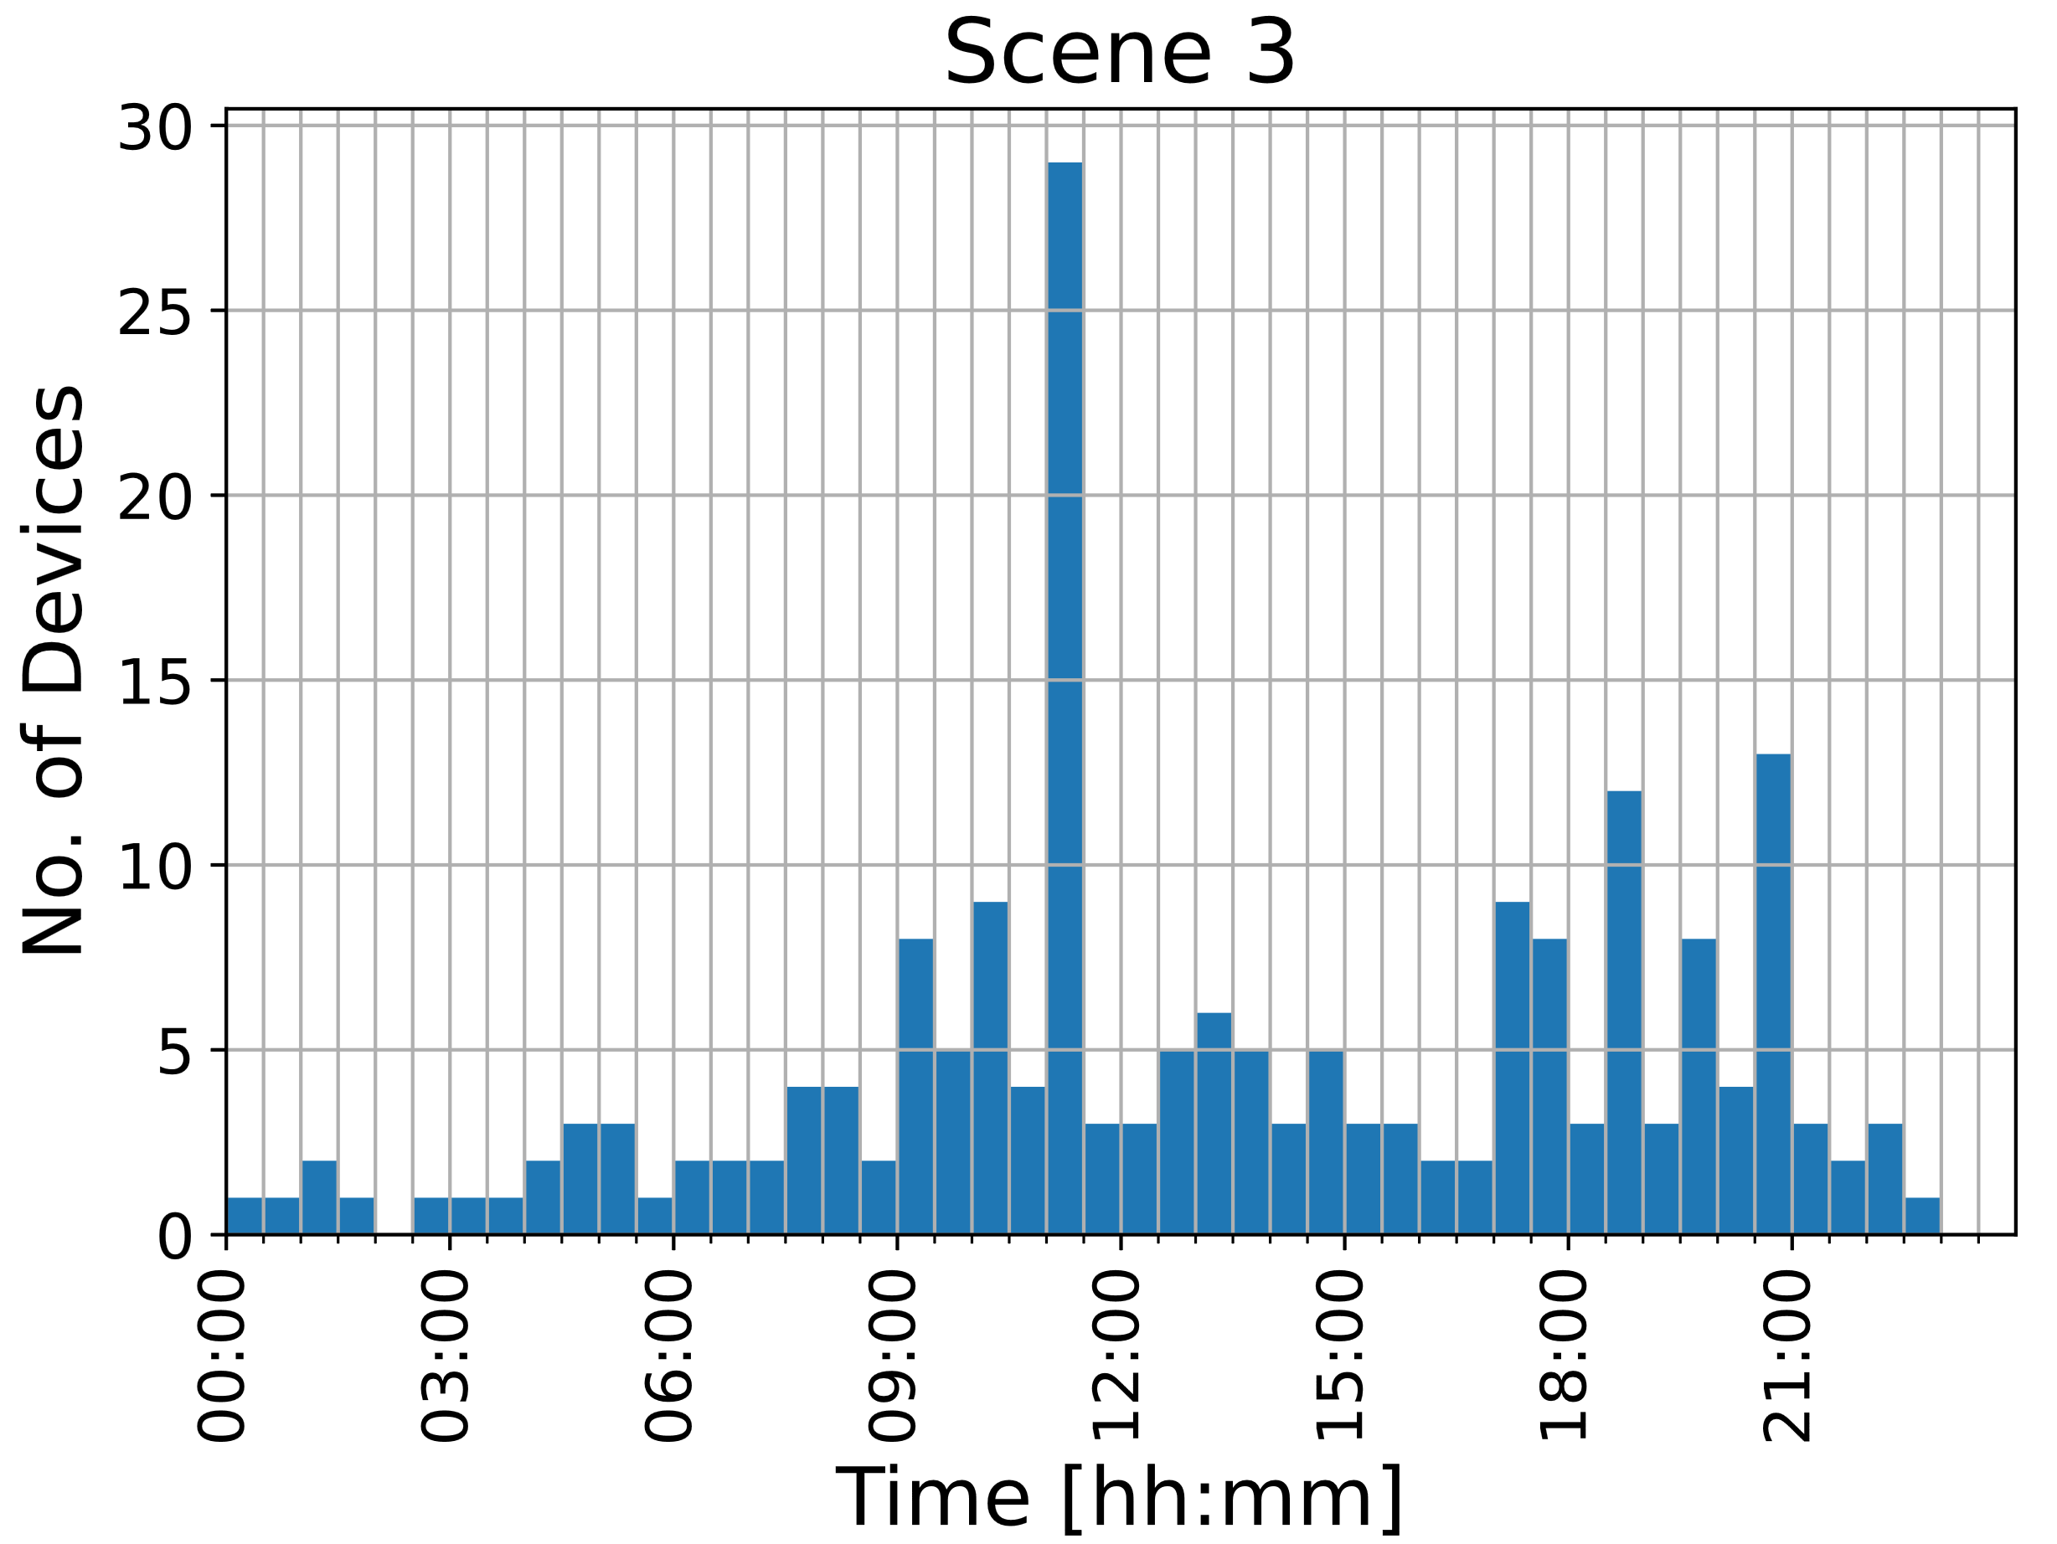
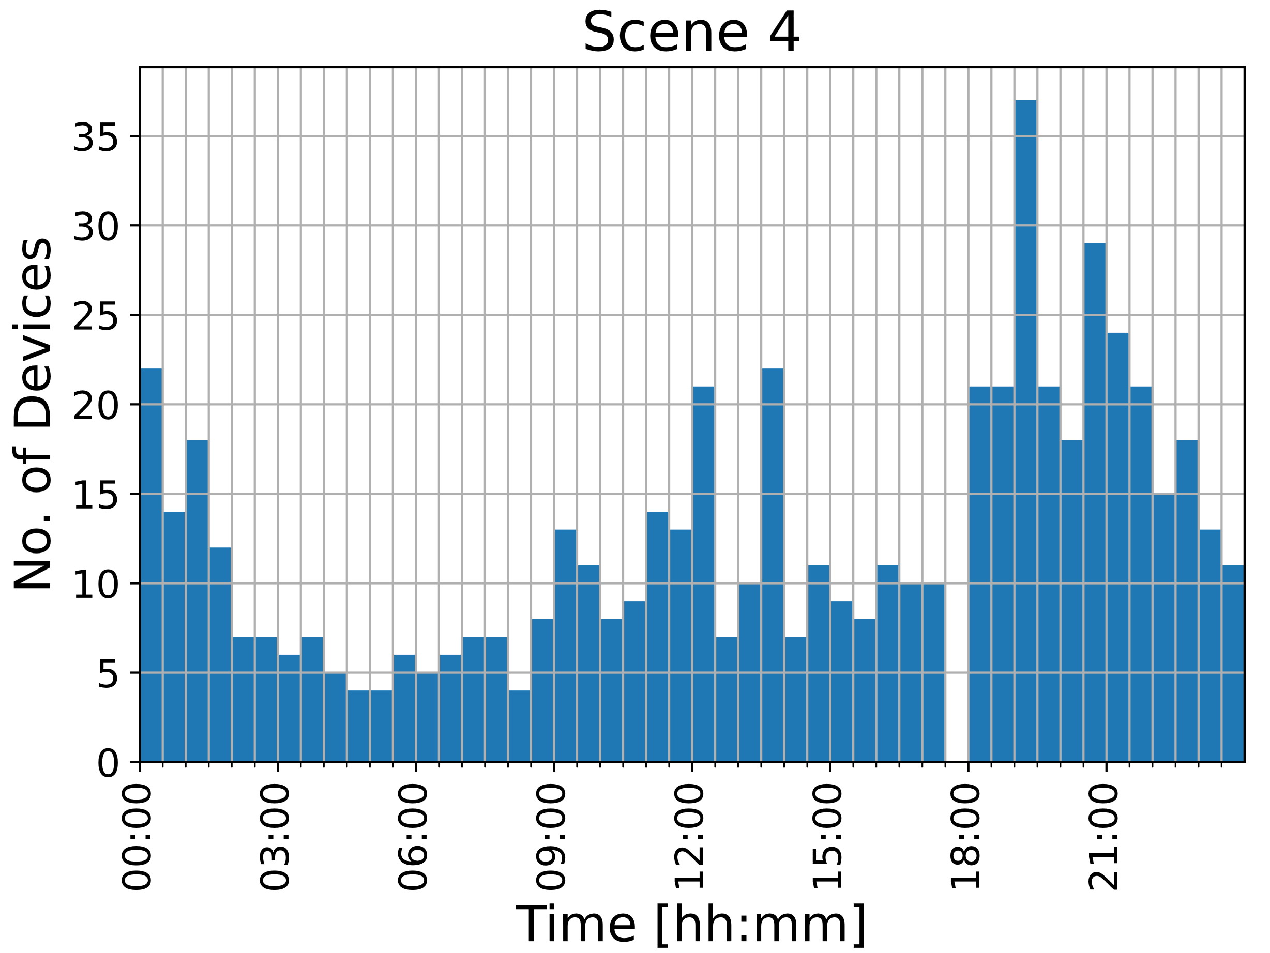
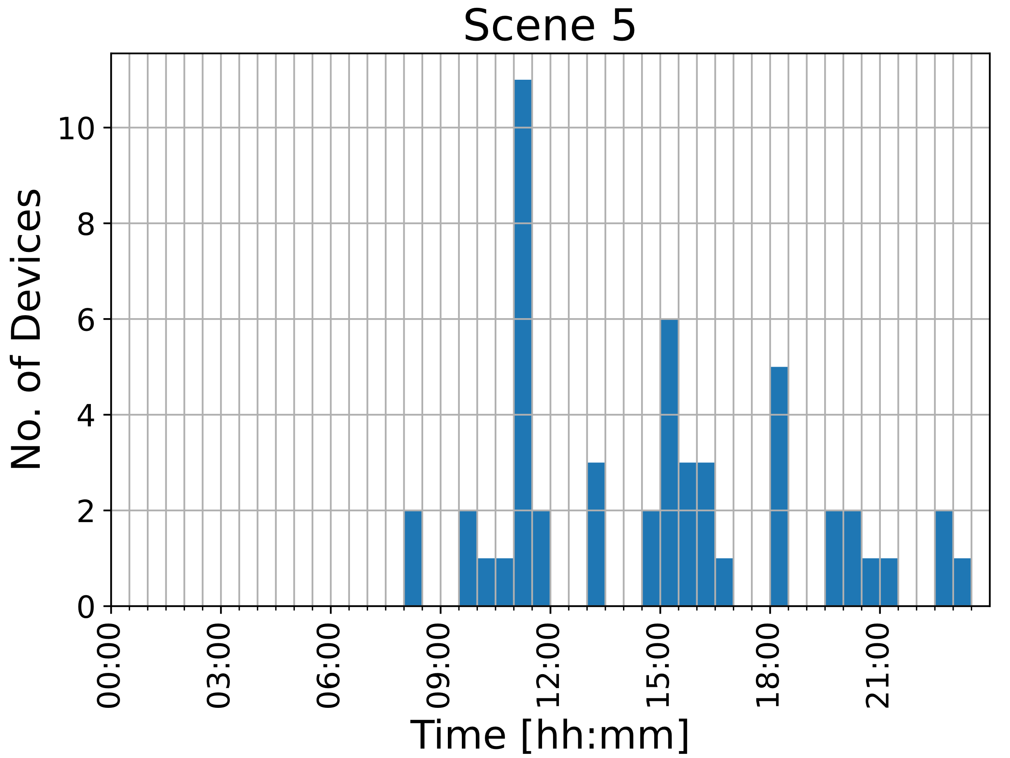
Scenes
Residential Building
Bicycle Parking
Corridor
Mailbox Room

Slide 5
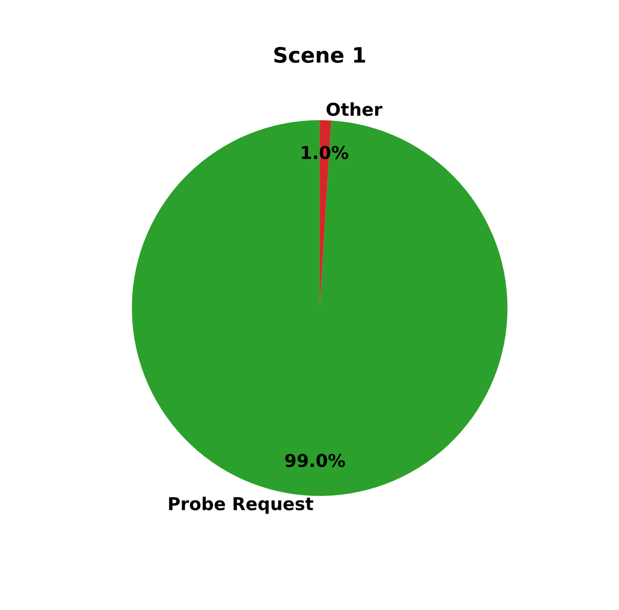
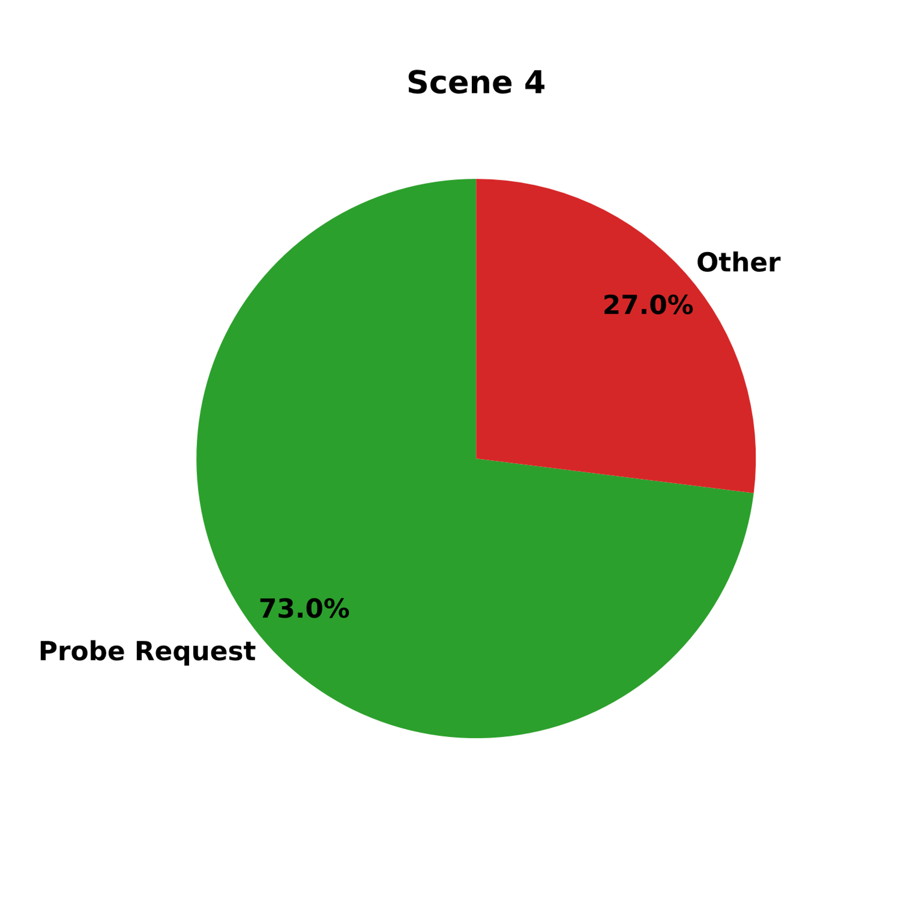
Means of detection
Delft Station Bicycle Parking 1
Residential Building Corridor

Slide 6
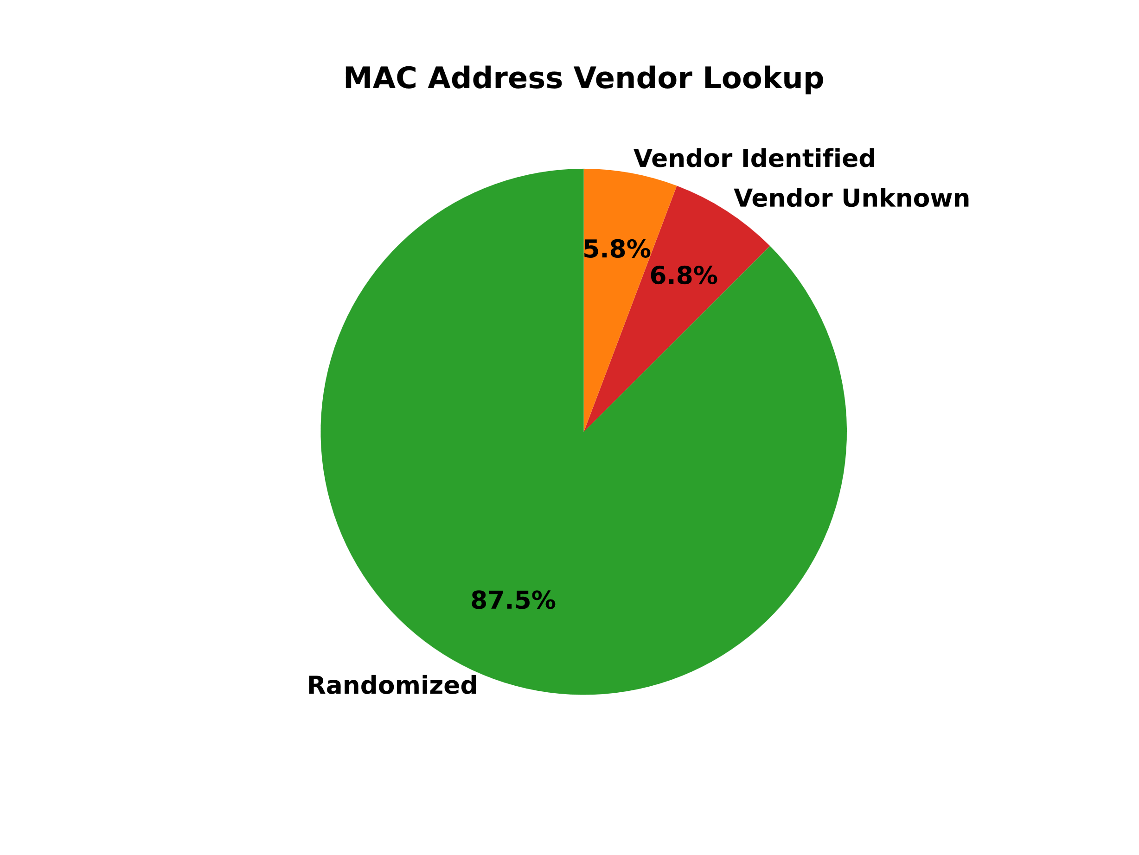
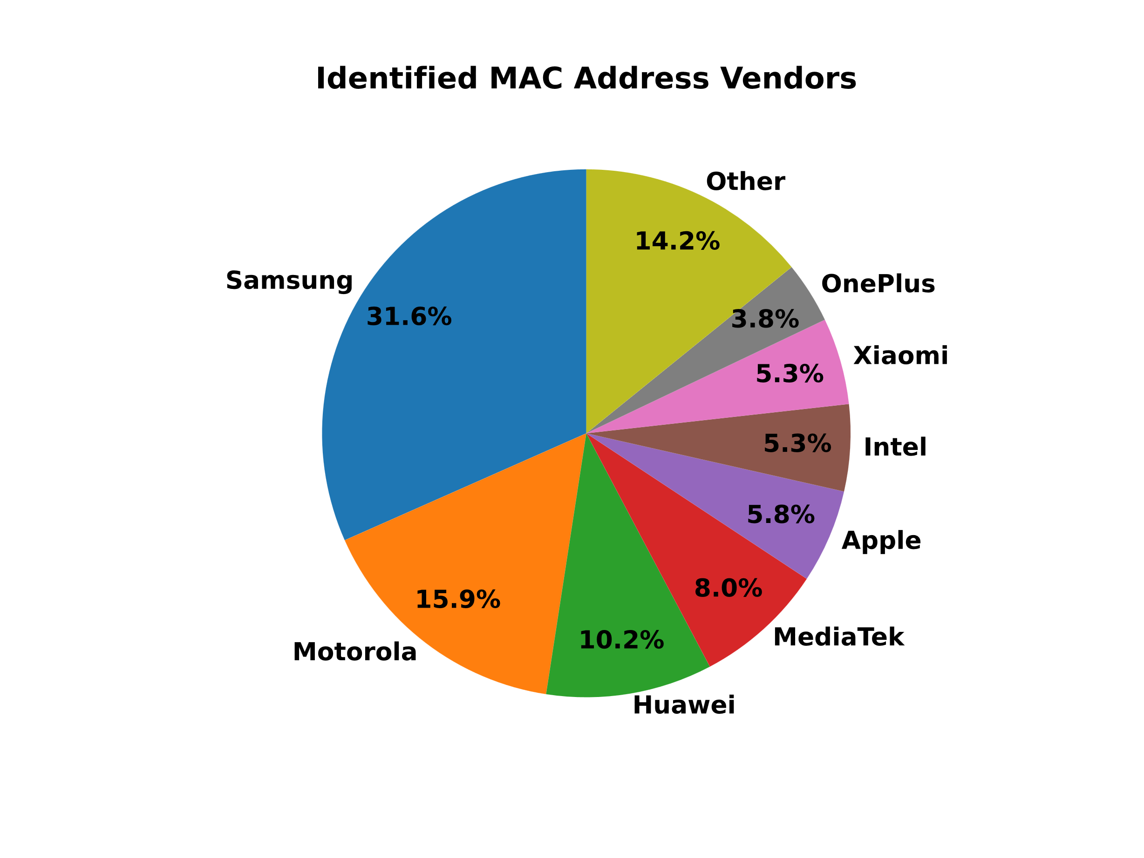
MAC address vendors

Slide 7

Questions

Slide 8
https://gitlab.ewi.tudelft.nl/et4394/2020-2021/wn-group-08

